Slide 1
Identifying Sensitive Content
Melvin Vellera, Lakshmi Manne

Slide 2

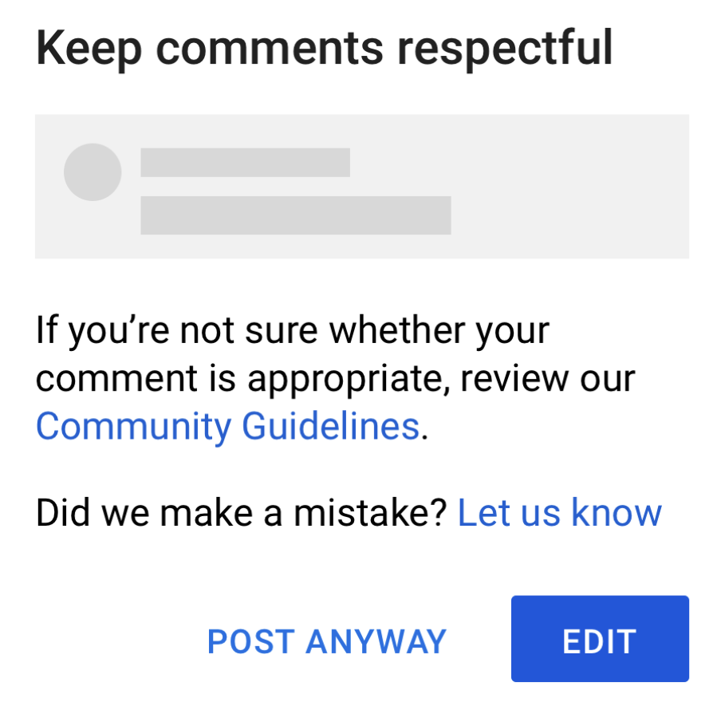
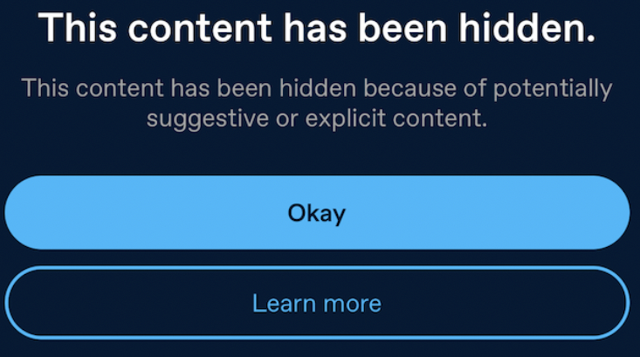

Project Goal
Building an NLP model using deep learning to identify if text content is sensitive
Provide explanations for why the text content is sensitive
Does it contain profanity?
Is there anything negative based on identity? (race, gender)
Does it contain threats?
We aim to use this model to flag negative content and help maintain a positive, safe, and collaborative social environment

Slide 3

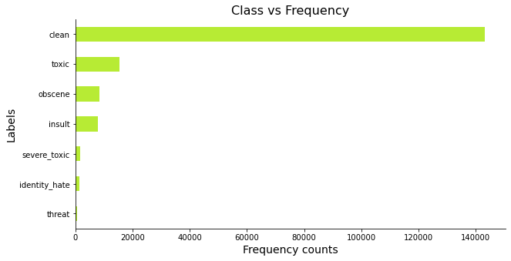
Data Exploration
90% of the comments are clean and do not have any sensitive content
There is imbalance among different labels

Slide 4
What did we try to achieve this goal?
Trained multi-label classification models with labels: toxic, severe_toxic, obscene, threat, insult, identity_hate
Experimented with LSTM, BERT, and RoBERTa to capture context and long-term word dependencies
Experimented with different preprocessing techniques
Removing symbols, hyperlinks, spaces, non alphanumeric characters
Stop words, lemmatization
Word, subword tokenization
Max sequence length
Tried weighted loss for handling class imbalance
Assessed model performance using appropriate metrics and intuitive checks

Slide 5
What went well?
Final model had good accuracy and recall
The model was able to identify sensitive content along with the reasons why it was classified as sensitive: threat, insult, obscene etc
Passed intuitive checks
I will look for you, I will find you and I will kill you => Threat
Were you always this stupid or did you take lessons? => Insult
You suck! => Obscene, Insult
Transformer models improved performance compared to LSTM

Slide 6
What didn’t go well?
Training and inference time took a long time
Training on 150K sentences took 90 minutes for a single epoch (BERT, RoBERTa)
Inference for 90K sentences took around 10 minutes
Using class weights for addressing imbalance did not lead to significant improvements in the transformer models
Freezing BERT model weights did reduce training and inference time but didn’t give better results
Not able to pick up on subtle insults
Examples: Hey, where'd you get those clothes, the toilet store?

Slide 7
Performance Metrics
Metric (Validation) | LSTM | LSTM with Weights | BERT | BERT with Weights | RoBERTa | RoBERTa with Weights
Accuracy | 0.91 | 0.90 | 0.927 | 0.925 | 0.926 | 0.925
Micro F1 score | 0.69 | 0.67 | 0.79 | 0.79 | 0.79 | 0.78
Macro F1 score | 0.46 | 0.48 | 0.66 | 0.63 | 0.64 | 0.63
We chose BERT as the best performing model and used it to classify the comments in the test set. The results are as below:
Accuracy: 0.88
AUC (Micro): 0.88
AUC (Macro): 0.82
F1 score (Micro) : 0.69
F1 score (Macro): 0.62
BCE Loss: 0.06

Slide 8
Performance Metrics
Labels (Test) | Precision | Recall | F1-Score | Support
toxic | 0.56 | 0.90 | 0.69 | 6090
severe_toxic | 0.39 | 0.42 | 0.40 | 367
obscene | 0.62 | 0.80 | 0.70 | 3691
threat | 0.58 | 0.58 | 0.58 | 211
insult | 0.70 | 0.72 | 0.71 | 3427
identity_hate | 0.69 | 0.56 | 0.61 | 712

Slide 9
Thank you for listening!

